Slide 1
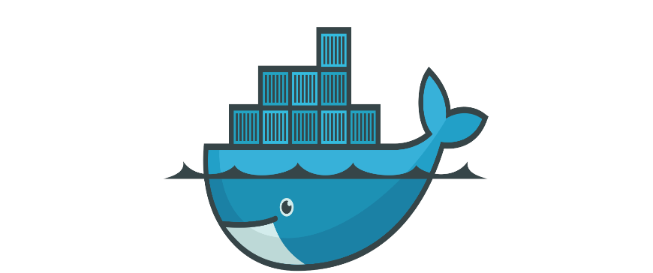
YouTube clone
using
Docker in AWS & Azure
BY
KORADA VIJAYA ANJALI
ADITYA UNIVERSITY
21A91A6148

Slide 2
INDEX
INTRODUCTION
TECHNOLOGIES USED
WHY DOCKER
AWS and AZURE
DEPLOYMENT
RESULTS
CONCLUSION

Slide 3
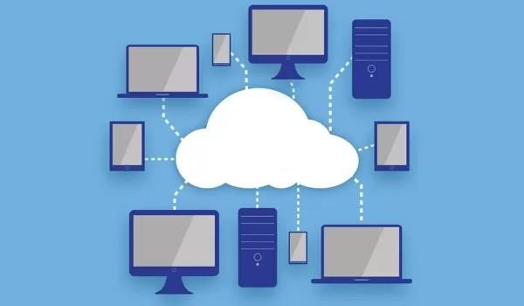
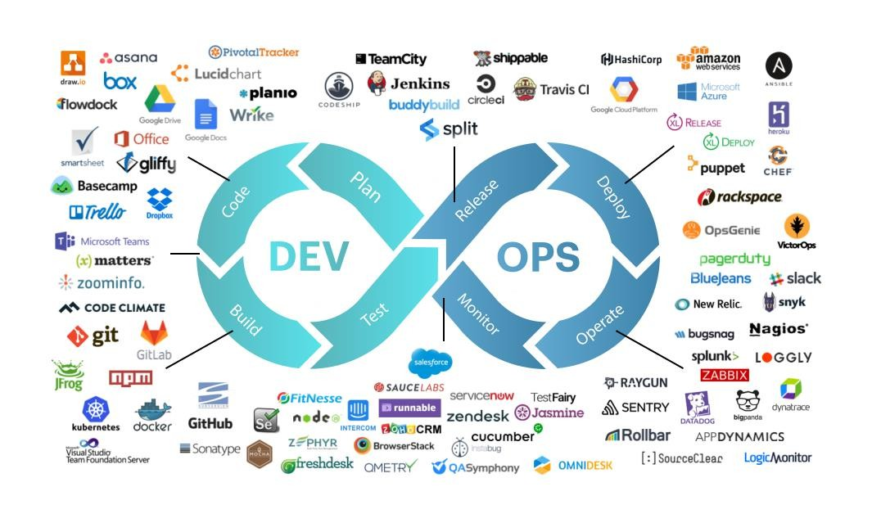
01. Introduction
Cloud is the delivery of computing services including servers, storage, databases, networking, software, and more over the internet ("the cloud").
DEVOPS: It aims to automate the process of software delivery, DevOps practices include continuous integration, continuous delivery, infrastructure as code, automated testing, and monitoring
Docker: Docker is a platform that enables developers to create, deploy, and run applications in isolated containers, ensuring consistency across multiple environments.

Slide 4
02.TECHNOLOGIES USED
AWS
EC2
APACHE SERVER
AZURE
VIRTUAL MACHINE
DOCKER
GITHUB

Slide 5
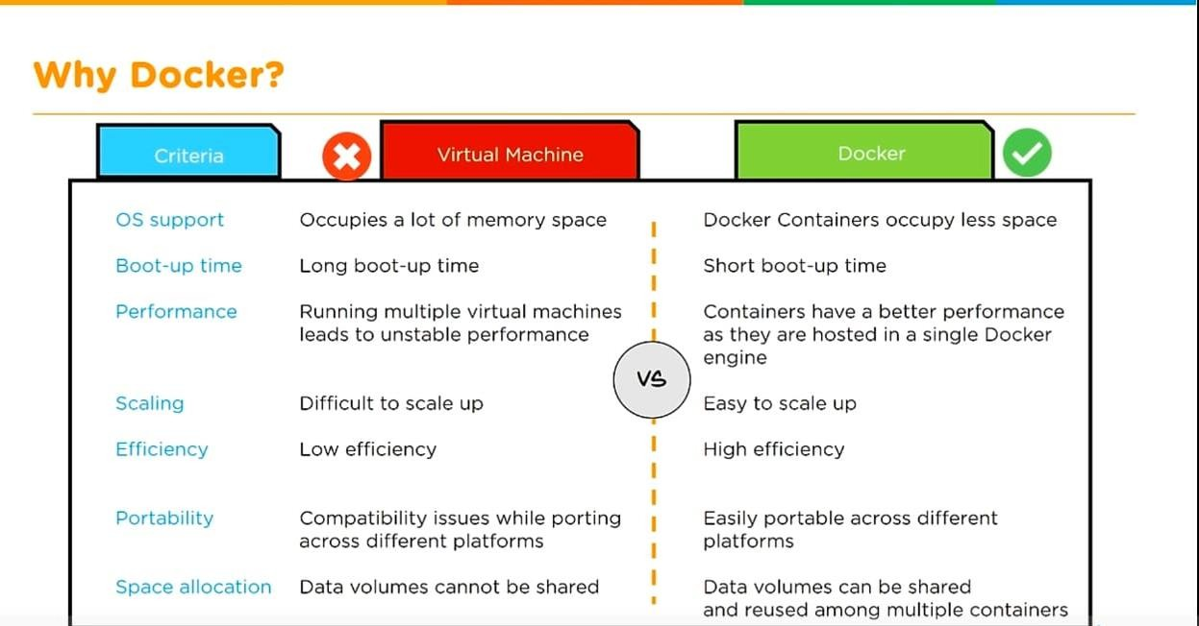
03. WHY DOCKER

Slide 6
04. AWS & AZURE
AWS:
Azure:
Launched in 2006
55 availability zones
40% worldwide
Netflix, Samsung, BMW, MI etc..
Open Source
Free tier eligible
0.0928 per hour ec2 cost
Launched in 2010
44 availability zones
30% worldwide
Johnson Controls, adobe, hp etc..
Open source
Free tier eligible
0.096 per hour vm cost

Slide 7
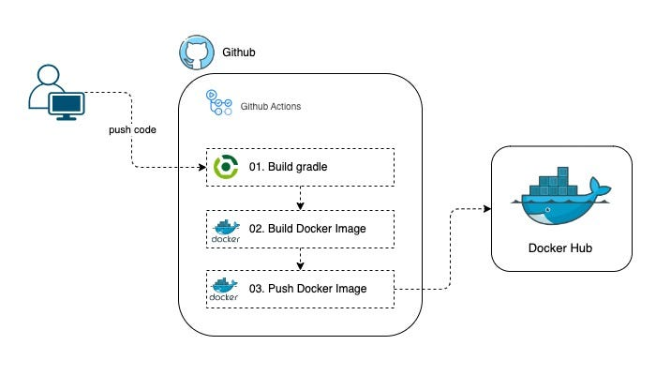
05. DEVELOPMENT

Slide 8
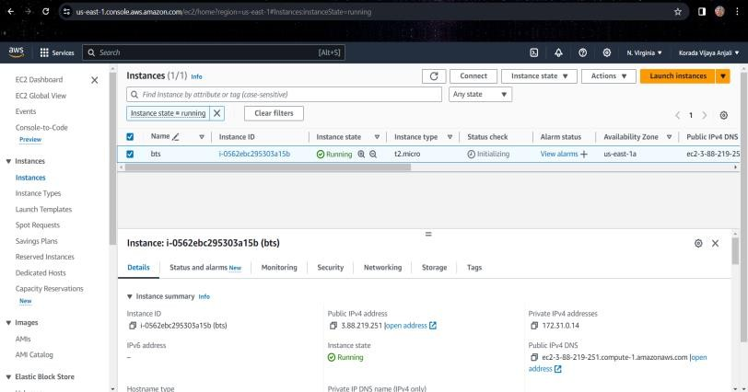
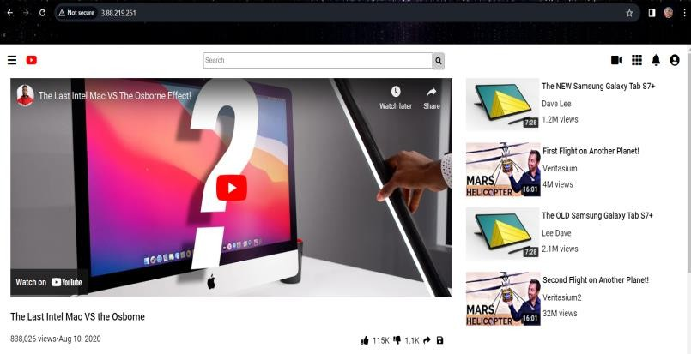
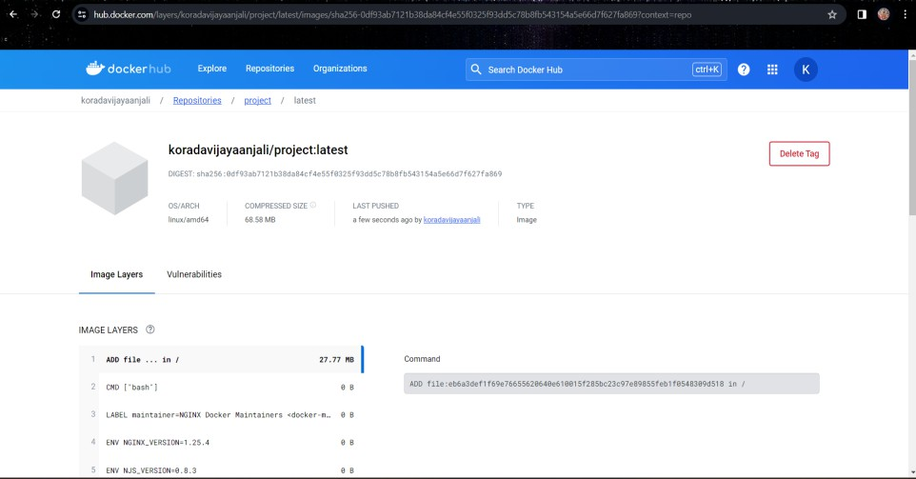
06.RESULTS

Slide 9
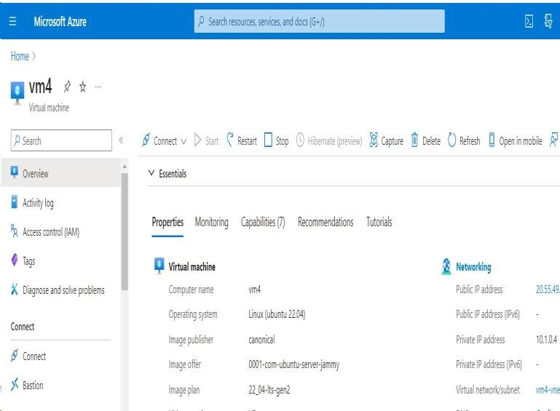
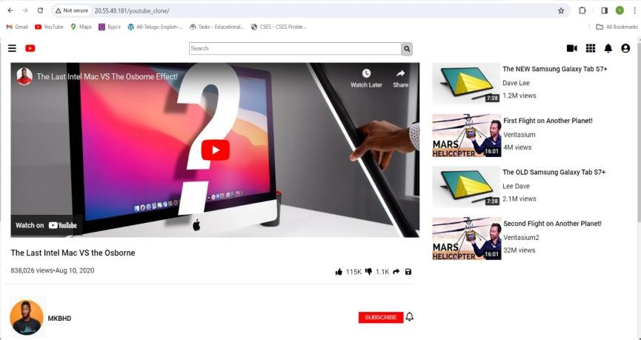

Slide 10
07. CONCLUSION
In conclusion, the implementation of Docker for hosting our website has proven to be a transformative solution, offering unparalleled flexibility, scalability, and efficiency. By containerizing our web application, we've achieved seamless deployment across various environments, simplified maintenance, and enhanced security through isolation.
Furthermore, Docker's ecosystem has empowered our team to streamline the development process, enabling rapid iteration and experimentation while maintaining consistency across development, testing, and production environments.
This project underscores the immense value Docker brings to modern web hosting, positioning us for continued success in the dynamic digital landscape.

Slide 11


